Slide 1


“Capacity building of veterinary and plant health services in the Western Balkans - Lot 1 - Animal Health” - ADEWB II
SANTE/2022/EA-OP/0001
Safe packaging and transport of diagnostic material and communication protocols with the laboratory
​
14-15 April 2025, Faculty of Veterinary Medicine - Skopje
04
Pathogen Management
Effective biosecurity involves managing and controlling pathogens securely.
02
Scope of Biosecurity
It includes administrative, regulatory, and physical security measures.
01
Definition of Biosecurity
Biosecurity refers to measures preventing loss, theft, misuse, or release of pathogens.
05
Compliance and Regulation
Adhering to biosecurity regulations is crucial for safety and security.
03
Purpose of Biosecurity
The aim is to safeguard public health and prevent biological threats.

Slide 2
GENERAL PRINCIPLES FOR SAMPLE PACKAGING AND TRANSPORTATION
This procedure is designed to safeguard the integrity of specimens, ensuring they arrive at the laboratory in optimal condition for testing.
The packaging will also minimize the risk of exposure to:
those involved in transportation,
protect the environment,
susceptible animal populations, and
ensure the safety of laboratory personnel from potential hazards.

Slide 3
PACKAGING
Always conduct the packaging of collected samples in a clean area, away from the sampling site.
To minimize the stay of the personnel how is taking the samples in the infected zone
To secure the collected samples
To avoid contamination of the secondary and the tertiary packaging, as well as the accompanying forms and documentation
To have undisturbed
The package shall be sturdy to avoid damage and leakage of specimens in case it is crushed.
At least secondary or outer package shall be sturdy.
Leave the secondary and the tertiary containers in a “clean area”, do not bring them to the sampling site.

Slide 4
PACKAGING
Minimum requirements for the transport of biological material follow the principle of triple packaging:
Primary receptacle;
Secondary packaging; and
Outer packaging.

Slide 5
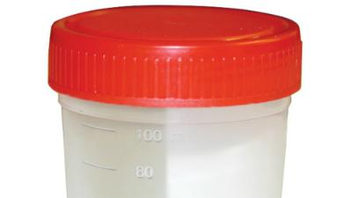
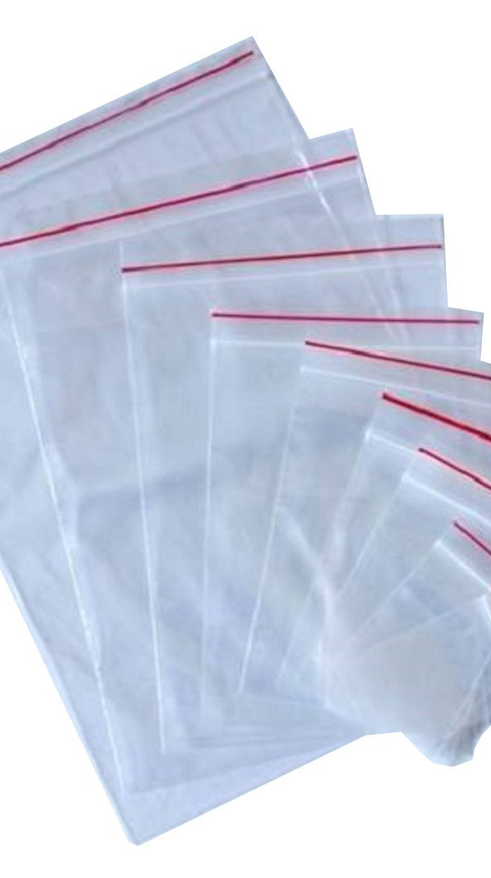
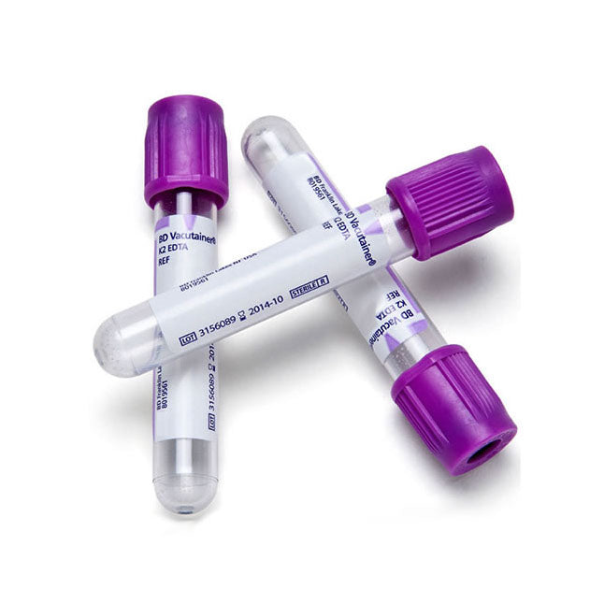
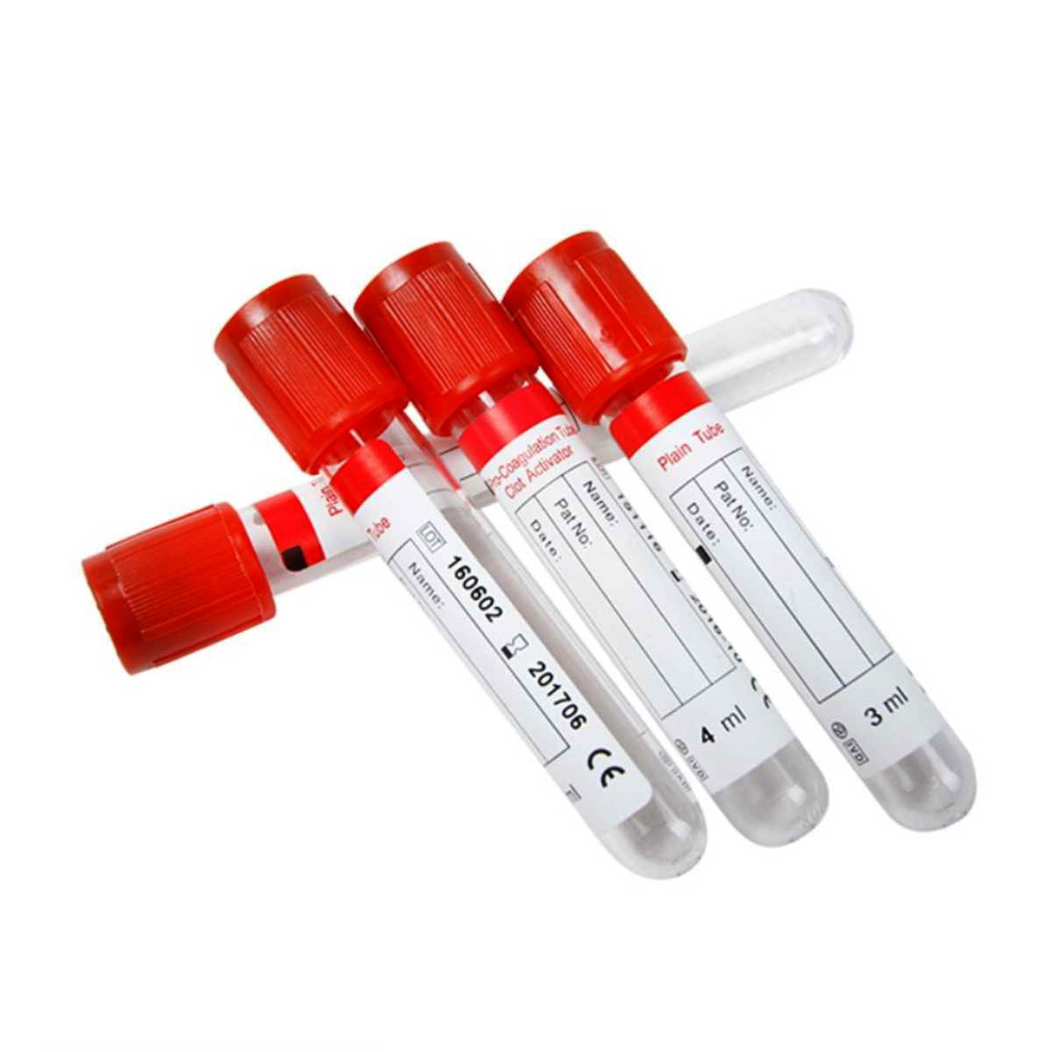
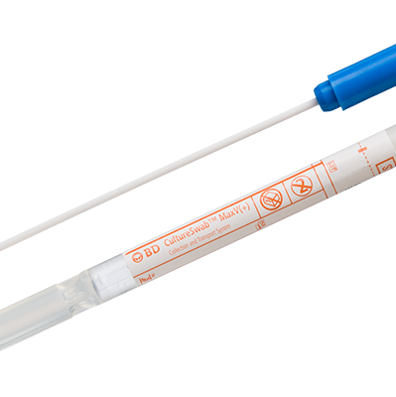
PRIMARY RECEPTACLE
Swab,
vacutainer,
small plastic screw cup container, or
small sealable/zip lock bag

Slide 6
Primary receptacle shall be used for one specimen from a single animal
One specimen may consist several samples:
different organs (spleen, tonsils, etc.)
Primary receptacle must be leak-proof for liquid specimens or sift-proof.
If not sure, use glued tape.
If sealable/zip lock bags are used, let out the air before sealing.
If pooled samples are required, contact the laboratory.

Slide 7

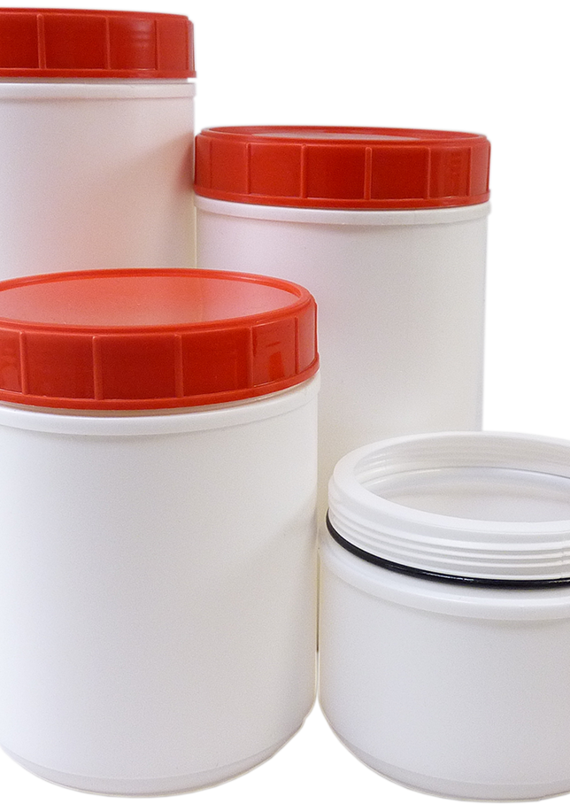
SECONDARY PACKAGING
A large enough zip or
A large enough plastic box.

Slide 8
Use the secondary packaging to pack multiple primary receptacles from single animal
Label the secondary package using the same ID as for the animal from which the samples were obtained.
Primary receptacles shall be placed with the lid facing up (vertical position).
Secondary packaging must be leak-proof or sift-proof.
Place sufficient quantity of absorbent material (paper, cotton, or similar) in the secondary packaging to avoid leakage of specimens and to serve as a barrier between primary receptacles.
Clean and disinfect the secondary packaging from the outside prior to placing it in the outer packaging.

Slide 9
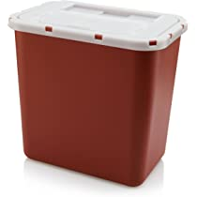
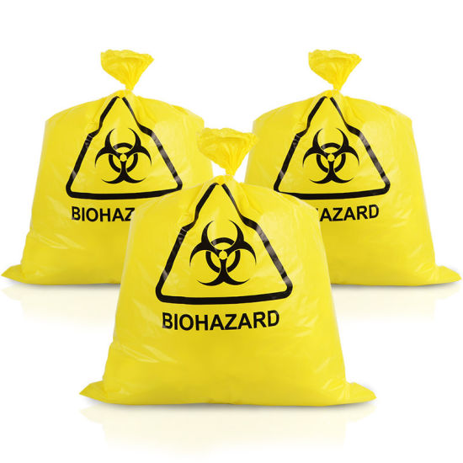
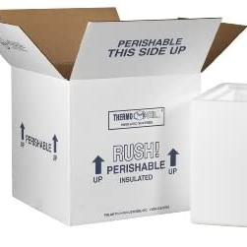

TERTIARY PACKAGING
TERTIARY PACKAGING
Styrofoam Box
Cardboard Box
Plastic cooling box (refrigerator)
A sturdy plastic bag.

Slide 10
The outer packaging shall be sturdy to protect the integrity of the samples.
In case of large specimens (whole carcass, bone or similar ), the outer packaging may be sufficiently hard plastic bag.
Place all secondary packages in an outer package containing sufficient quantity of chilled ice packs to maintain the cold chain during the transport.
It is not recommended to use wet ice (the package may leak).
Clean and disinfect the outer packaging from the outside prior to handing it to the transporter or placing it in the transportation vehicle.

Slide 11
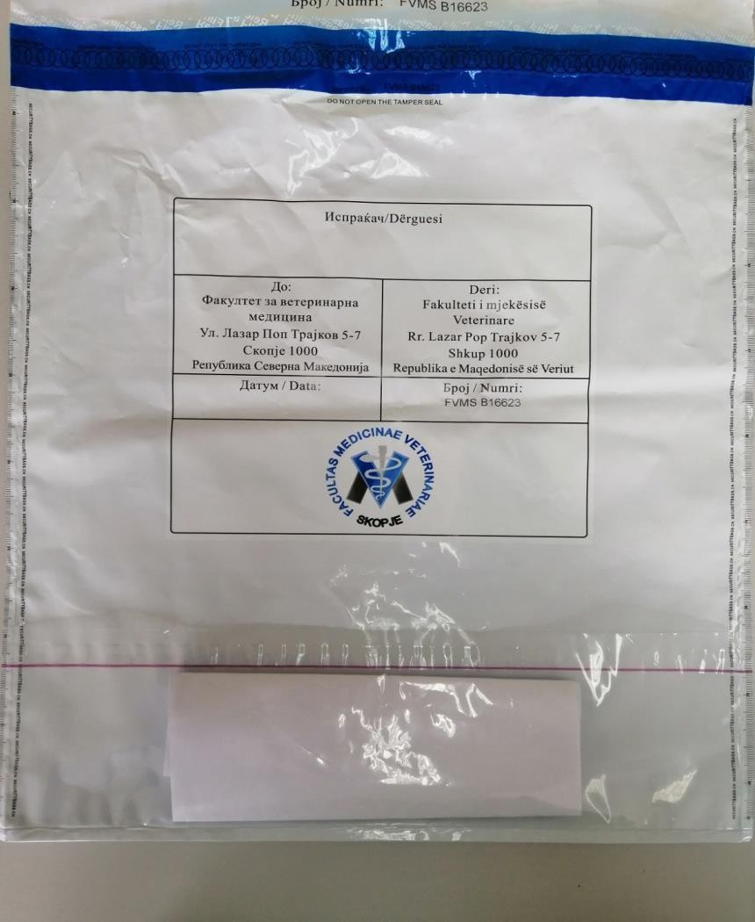
TERTIARY PACKAGING
The accompanying documents are placed in a clean, waterproof zip bag, and adhered to the outside of the package.
It is recommended that the supporting documents be photographed and sent to the laboratory prior to transportation of the materials.
This allows for the preparation and initiation of laboratory procedures prior to the receipt of materials.
Documents and forms

Slide 12

STORAGE AND TRANSPORTATION
It is necessary to ensure proper temperature control during transport to keep specimens in the best condition to obtain a proper diagnosis.
In general, samples should be stored in a refrigerated container (about 2–8 °C) if transport to the laboratory takes less than 48 hours.
In situations where the delivery of samples is prolonged, they should be stored at a temperature of −20 °C.
Transportation of specimens should always be carried out by professional persons who have undergone appropriate training in the transport of infectious material (avoiding contact with unauthorised persons).

Slide 13
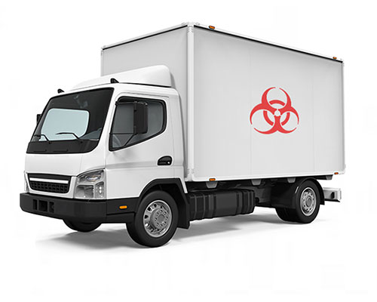
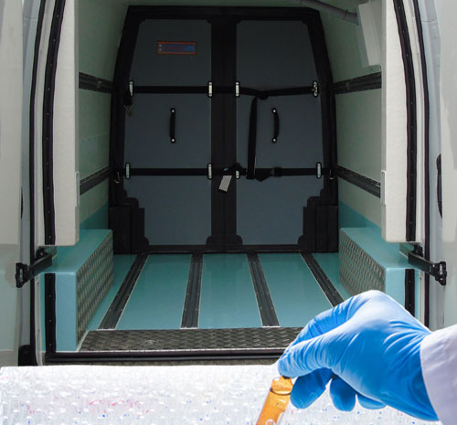
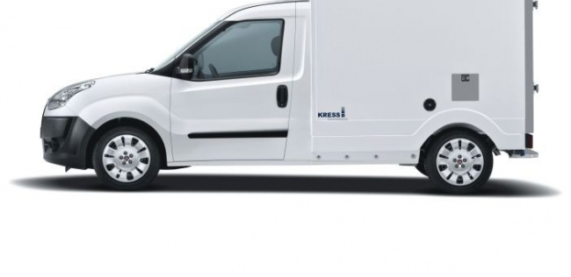
STORAGE AND TRANSPORTATION
Vehicles used for transportation must meet the following requirements:
  to ensure safe transport and prevent the dispersal of infectious material en route to the laboratory;
  to provide conditions for thorough cleaning and disinfection after delivery of samples; and
  Ensure that conditions are maintained at an adequate temperature during transport.

Slide 14

STORAGE AND TRANSPORTATION
If the shipment is carried out by persons (or a designated company) who are not present at the time of material collection, they must be notified in a timely manner so that there is no delay in the delivery of samples.
Diseases that have the potential to spread beyond state borders, as well as exotic diseases, are a priority and should be analysed as a matter of urgency.
Therefore, the shipment of materials should also be announced to the laboratory.

Slide 15

PROTOCOL FOR COMMUNICATION WITH THE LABORATORY
  The laboratory should provide a list of a minimum of two contact persons (and at least their contact number) responsible for receiving and processing materials.
  Prior to forwarding field material, you should always inform the contact persons of the laboratory by TELEPHONE of the arrival of the shipment.
  This will ensure prompt receipt of shipments and proper preparation by laboratory staff.
  Additionally, notice may be sent via e-mail or other electronic format if possible.
  The notification to the laboratory itself should include information about the estimated time of arrival of the shipment, the person or company responsible for transportation, the type and number of samples to be sent, and a brief history report.
Upon receipt at the laboratory, the person responsible for transportation should notify the sender of the successfully completed delivery.

